Slide 1
Impact of Climate Change on Agricultural yield
AIML Specialization Course
2022-26
By:
Atharva Gondhali (CS A2 - 22070122038)
Dhruva Kashyap (CS A2 - 22070122055)

Slide 2
Contents
Introduction
Literature Survey
Methodology
Result
Conclusion
Reference

Slide 3
Introduction
Climate change has been a growing concern for its profound impacts on agriculture. As temperatures rise and weather patterns become more unpredictable, crop yields and farming practices are increasingly affected, with direct consequences on global food security and economies.
The dataset titled "Climate Change Impact on Agriculture" from Kaggle contains valuable information, tracking various climate variables and agricultural outputs. By analyzing this dataset, we can gain insights into how climate change is affecting crop production and how we might predict future trends.
The Climate Change Impact on Agriculture dataset includes features such as temperature, rainfall, CO2 emissions, and humidity, and is used to predict crop yields and agricultural productivity in the face of evolving climate conditions.
Our goal is to develop a machine learning regression model to accurately predict crop yields based on climate variables. The process involves data preprocessing, feature selection, model training, and performance evaluation. Accurate predictions can inform agricultural practices and adaptation strategies, contributing to enhanced food security and sustainability in the face of climate change.

Slide 4
Literature Survey
S. No | Title | Author | Work | Conclusion
1 | Impacts of Climate Change on Agriculture: A Review | M. A. Adnan, H. A. Adnan, M. F. Shahid | This review summarizes the effects of climate change on agricultural productivity, focusing on temperature and precipitation changes. It highlights various adaptation strategies employed by farmers to mitigate the negative impacts. | The paper emphasizes the need for integrated climate-smart agricultural practices to ensure food security. It also suggests that further research is needed to refine predictive models for better adaptation strategies.
2 | Predicting Crop Yield Using Machine Learning Algorithms: A Case Study of Maize | N. Sharma, R. K. Singh, P. K. Gupta | This study employs machine learning techniques, including regression and neural networks, to predict maize yields based on climatic and soil variables. The model achieved a significant improvement in prediction accuracy compared to traditional methods. | The findings indicate that machine learning can effectively enhance yield predictions, providing a valuable tool for farmers and policymakers. Future work should focus on incorporating more diverse data sources for improved accuracy.
3 | Assessing the Impact of Climate Variability on Crop Production: A Systematic Review | S. Z. S. Khan, T. R. Kumar, A. P. Ghosh | This systematic review analyzes multiple studies on the effects of climate variability on crop yields across different regions. It discusses the role of specific climate factors and their interactions affecting agricultural productivity. | The review concludes that climate variability significantly impacts crop production, necessitating tailored adaptation strategies. It calls for more localized studies to provide actionable insights for farmers.
4 | Machine Learning for Predicting Agricultural Yield: A Review | A. J. Patel, B. R. Das, C. L. Sharma | This paper reviews various machine learning approaches for predicting agricultural yield, assessing their strengths and weaknesses. It highlights the importance of feature selection and data quality in model performance. | The review suggests that machine learning holds great promise for enhancing yield predictions in agriculture. It emphasizes the need for interdisciplinary collaboration to improve model robustness and applicability.

Slide 5
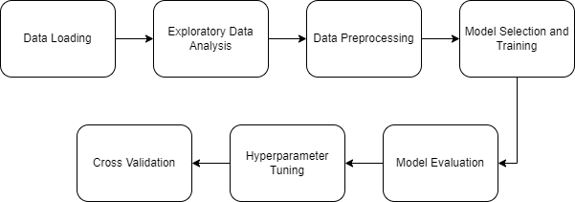
Methodology
Data Collection: Gathered the Energy Efficiency dataset, which includes features such as building orientation, glazing area, and insulation quality.
Exploratory Data Analysis (EDA): Conducted EDA to identify patterns, correlations, and anomalies within the dataset.
Data Preprocessing: Cleaned and transformed the data, handling missing values and normalizing numerical features to enhance model performance.
Model Selection: Evaluated multiple regression models, including Linear Regression, Random Forest, Gradient Boosting, and XGBoost.
Hyperparameter Tuning: Fine-tuned the Best model using Random Search CV
Insights and Recommendations: Provided actionable insights for enhancing building energy efficiency based on model predictions.

Slide 6
Results
Correlation Analysis: Crop_Yield_MT_per_HA has good correlations with Average_Temperature_C, Economic_Impact_Million_USD
RMSE Score:
Gradient Boosting – 0.663
Random Forest – 0.675
XGBoost– 0.712
Linear Regression – 0.722
Model selected for hyperparameter tuning – Gradient Boosting
Tuned model RMSE Score: 0.662
Final model selected – Tuned Gradient Boosting
Cross Validation Results(10 sets):
Mean RMSE Score – 0.6373
Standard Deviation of RMSE scores – 0.0139

Slide 7
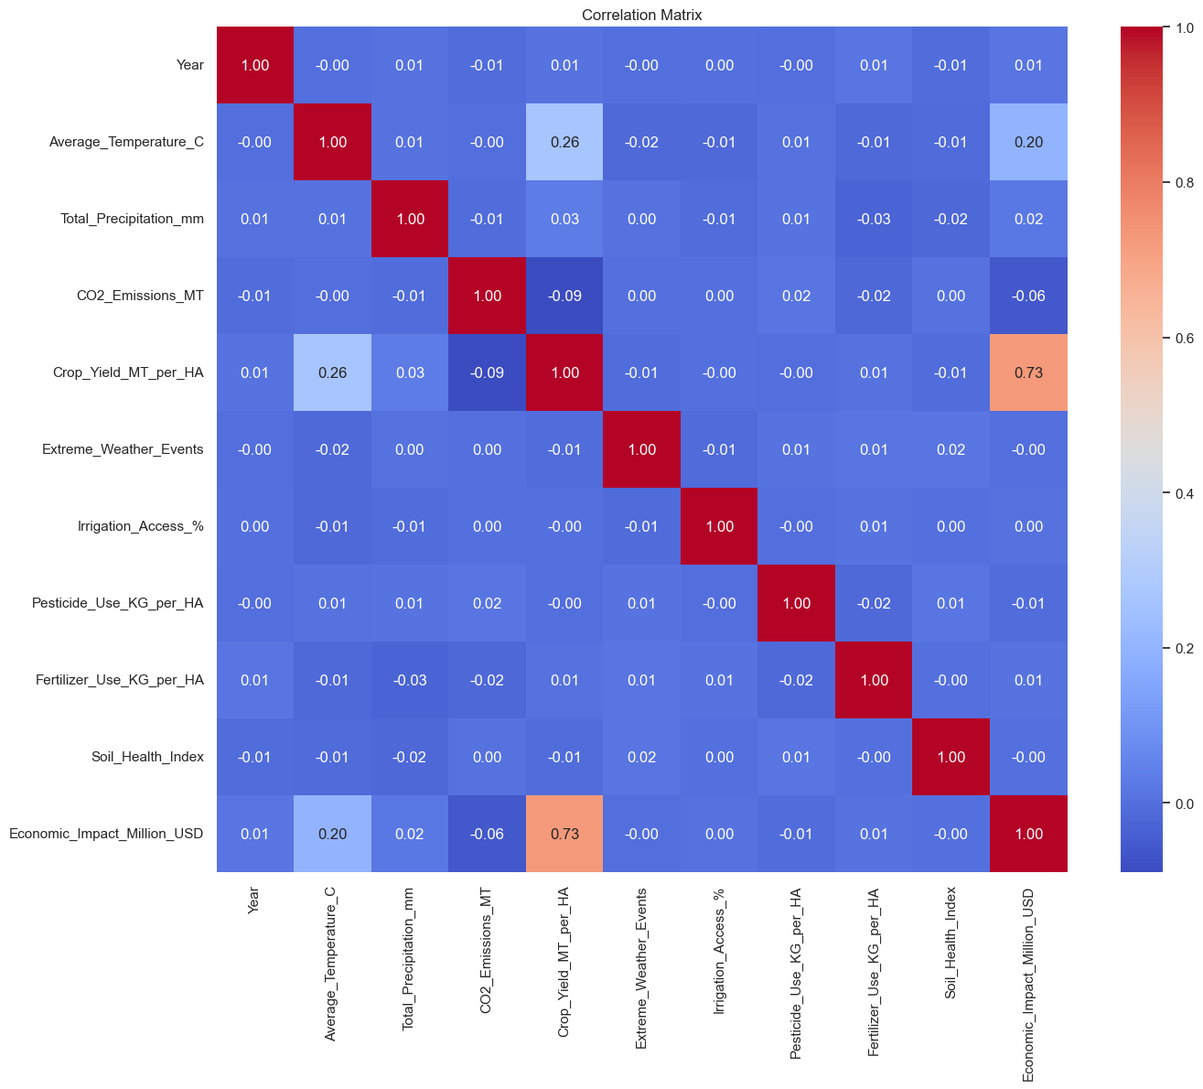

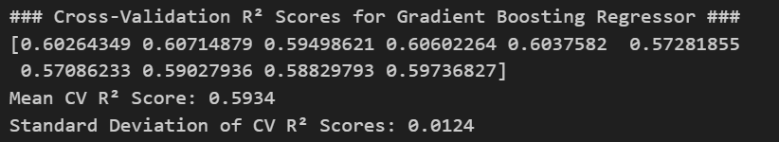
Results
Model evaluation
Final Cross validation result
Correlation matrix

Slide 8
Conclusion
In this project, we explored machine learning models for classifying building energy efficiency using architectural and environmental features.
The data is very less correlated among both independent and dependent features, which balanced out the learning of model.
Gradient Boosting emerged as the best-performing model, with an RMSE score of 0.662, outperforming other models like Random Forest and XGBoost.
After hyperparameter tuning, the tuned Gradient Boosting model was selected due to its robust performance. Cross-validation yielded a mean RMSE score of 0.637 with a standard deviation of 0.0139, indicating stable generalization. This model provides actionable insights for predicting agricultural yield.
This model offers valuable insights for optimizing building energy efficiency through data-driven decision-making.

Slide 9
References
Dataset: https://www.kaggle.com/datasets/waqi786/climate-change-impact-on-agriculture
Research paper:
https://www.sciencedirect.com/science/article/abs/pii/S1364815217300405
https://link.springer.com/article/10.1007/s10479-020-03764-2
https://www.sciencedirect.com/science/article/pii/S2351978918300139

